Slide 1
Machine Failure Prediction
Predictive Maintenance using Logistic Regression

Slide 2
Introduction
Predicting machine failures is crucial for reducing downtime and maintenance costs. Machine failure prediction allows companies to perform predictive maintenance, enhancing operational efficiency and preventing costly unexpected downtimes. Logistic Regression serves as a key tool for binary classification tasks in this context, determining whether a machine will fail or not.

Slide 3
01
Dataset Overview

Slide 4

Sensor data features
The dataset comprises various sensor data features, including:
- Footfall: Tracks the number of people accessing the machine.
- Temperature: Measures the operational temperature to prevent overheating.
- Air Quality: Assesses environmental conditions that may impact machine operation.
- Ultrasonic Sensor: Monitors proximity and detects any obstructions.
- Current Sensor: Measures electrical current to identify anomalies.
- VOC: Volatile organic compounds that may indicate machine wear.
- RPM: Rotations per minute, reflecting machine performance.
- Input Pressure: Ensures optimal pressure levels to function properly.

Slide 5
Target variable definition
'Fail' is defined as the target variable in this dataset, where:
- A value of 1 indicates a machine failure.
- A value of 0 indicates that the machine did not fail.
Identifying these labels helps in training the logistic regression model, crucial for accurately predicting downtime events and enabling timely maintenance actions.

Slide 6
Importance of data quality
Data quality is fundamental in ensuring accurate machine failure predictions. Poor quality data can lead to incorrect conclusions and undermine the entire predictive maintenance strategy. Factors such as missing values, noise, and irrelevant features must be addressed during preprocessing. High-quality, consistent data enables the logistic regression model to learn effectively and improve its predictive capabilities, ultimately leading to better maintenance decisions and increased operational efficiency.

Slide 7
02
Model Training

Slide 8
Training process of logistic regression
The logistic regression model is trained using a portion of the dataset, typically with a train-test split method. The model learns to identify patterns that lead to machine failures based on the input sensor features. During training, the model adjusts weights assigned to each feature to optimize its ability to predict the target variable. This process includes iterative training where the model is fine-tuned until it reaches satisfactory performance based on the defined metrics.

Slide 9
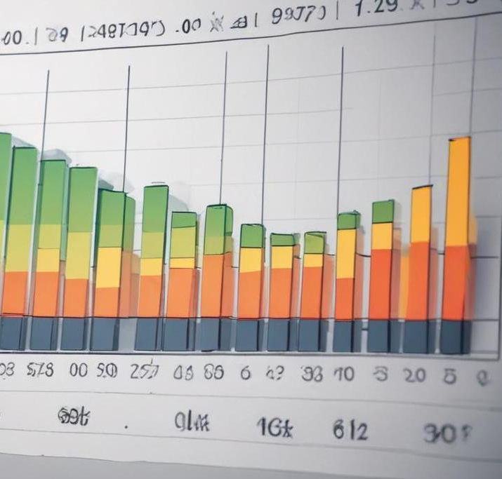
Performance metrics explanation
After training, the model's performance is evaluated using several key metrics:
- Accuracy: This represents the overall correct predictions made by the model, and in this case, it has achieved 85%.
- Recall: This measures the model's ability to identify actual failures, with a noted value of 80%. A high recall indicates that most failures are correctly predicted, minimizing false negatives, which is critical for effective maintenance.

Slide 10
Key findings and insights
The logistic regression model demonstrates significant potential for predicting machine failures effectively. The identified performance metrics indicate a strong ability to predict failures accurately. However, some limitations exist, such as the simplicity of the logistic regression approach and the model's sensitivity to imbalanced datasets. These insights underscore the need for continuous improvements and potentially exploring more complex models in future analyses.

Slide 11
Conclusions
In conclusion, effective machine failure prediction using logistic regression can significantly enhance maintenance strategies and operational efficiency. Despite its limitations, the model successfully identifies failure risks, promoting proactive maintenance. Future work may involve exploring advanced models to accommodate complex scenarios and improve prediction accuracy.

Slide 12
Thank you!
Do you have any questions?

